Slide 1
Design Basis
Circulating Fluidized Bed Boiler
Dowon SHUN
Korea Institute of Energy Research
Notes:
산업용 보일러의 운전특성을 요약하였다.

Slide 2
Design Steps
Design Basis
Conceptual Design
Basic Engineering Design Data
Basic Design
Detail Design

Slide 3
Terminal points
Drum
To Steam
Generator
Cyclone
S/H2
Hopper
S/H1
SDR
Scrubber
Combustor
Eco
Water
A/H
Ash cooler
Air
ID Fan
FD Fan
Stack

Slide 4
Deliverables
Power Plant Project Management
Time, budget & Risk control
Plant
Manufacturing
Procurement
Design
Commissioning
Training
Construction
Plant Document
Maintenance Manual
KIER Involved
in yellow colored block
Basic Design by KIER

Slide 5
Design Steps
Conceptual Design
Boiler Specificatons
Contract
Basic Engineering Design Data
Heat Balance
Heat Balance
Pressure parts
Basic Design
Non-Pressure parts
Draft system
Detail Design
Drawing
Documents
Manuals

Slide 6
Design Basis

Slide 7
Facility and Accessories
1 | Boiler Proper and Accessories
2 | SNCR & SCR System
3 | FGD system
4 | Ash control system
5 | Oxy system
6 | Cooling water sytem

Slide 8
Boiler DESIGN REQUIREMENT I
Facilities | Items | Criteria | Ref.
CFBC | Unit | 1
 | type | Natural circulation
 | installation | In house
 | Power | 10MWe
 | Steam rate | 60ton/h
 | Final steam temp. | 452℃
 | Final steam pressure | 45ata
 | Feed water temp. | 143 ℃

Slide 9
Boiler DESIGN REQUIREMENT II
Facilities | Items | Criteria | Ref.
CFBC | Boiler efficiency | 83% | HHV
 | Process steam | 12ton/h | steam
 | Process steam P. | 12ata
 | Environment | 20 ℃
 | Humidity | 70%
 | Minimum loading | 50%
 | Support | suspended
 | Main fuel | RDF
 | Start up fuel | Diesel
 | Fuel consumption | 11ton/h
 | HHV of fuel | 4500kcal/kg

Slide 10
Design criteria of combustor
Simple → low cost, easy maintenance(unit module)
Easy operation → No hot spot, stable air distribution
Efficiency → Minimize dynamic resistance, high yield of steam
Environmental factor → low emission, no leak
Durability → Thermal corrosion, erosion, Clinker deposit, Chloride attack

Slide 11
Design factor
Site specific factor
Fuel and water availability, New or retrofit Plant, Power or steam generation purpose
Design variables
Boiler configuration, heat transfer method
Operating variables
Emission, Erosion, Clinker
Economics
Construction cost, operation cost

Slide 12
CFB Boiler for Fluff Fuel
Post combustion
Cyclone
Air heater
Low gas velocity
Empty pass
Convection pass
Combustor
ITEM | VALUE
Capacity | 35~75ton/h(5~15MWe)
Steam quality | 425℃ 45~60bara
USE | Waste to Energy
EHE

Slide 13
CFB Boiler for Sludge/Plastics fuel
Cyclone
Air
heater
Empty pass
ECO
Combustor
ITEM | VALUE
Capacity | 10~30ton/h(5~15MWe)
Steam quality | 200℃ 10~15bara
USE | Steam for Industry
Dryer
EHE

Slide 14
BFB Boiler for Biomass
Drum
ECO
2nd W/W
Empty pass
Combustor
ITEM | VALUE
Capacity | 10~20ton/h(5~15MWe)
Steam quality | 200℃ 10~15bara
USE | Steam for Industry

Slide 15
Conceptual Design

Slide 16
Conceptual design CFBC Co-generation Boiler
Drum
To Steam
Generator
Cyclone
S/H2
Hopper
S/H1
SDR
Scrubber
Combustor
Econ.
Water
A/H
Air
ID Fan
FD Fan
Stack

Slide 17
Conceptual Design
PROCESS DESIGN REQUIREMENT
Fuel analysis
Mass and heat balance
Steam utilization
Power
Steam and poser
Conceptual design of mechanical parts including Boiler type

Slide 18
Boiler Unit
Economizer heats incoming feed water using low temperature flugas of under 500℃
Evaporator is located hottest temperature zone since heat demand to convert water to steam is the highest.
Steam drum stores and saparates saturated steam from water.
Superheater converts saturated steam from drum to dry and hot steam for turbine

Slide 19
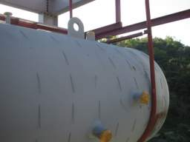
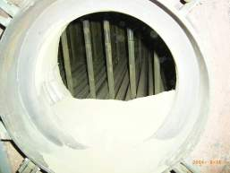
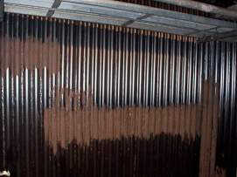
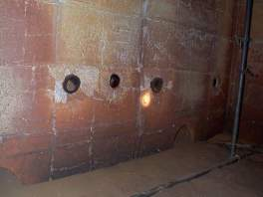
Dispatch of boiler units

Slide 20
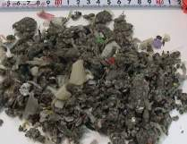
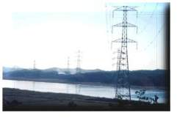
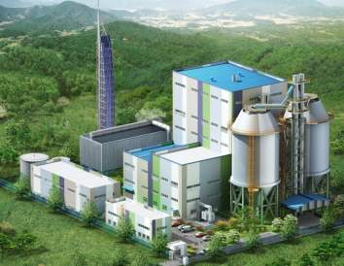

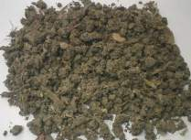
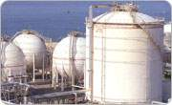
10MWe CFBC for RDF
Sox, Nox, HCl

Slide 21
Simple vs. Easy operation

Slide 22
Fuel feeding method
A
SA
B
A
coal
B
limestone
PA

Slide 23
Combustion
C + O2 -> CO2 + 32790kJ/kg carbon
S + O2 -> SO2 + 9260kJ/kg S

Slide 24
석탄의 성분에 따른 연소의 차이

Slide 25
순환유동층 보일러 기술-연구개발
연료의 반응성 차이에 따른 연소성
Bituminous coal
Anthracite
TGA study of the reactivity of coals

Slide 26
Chemical reaction
CaCO3 -> CaO + CO2 + 1830kJ/kg CaCO2
MgCO3 -> MgO + CO2 + 1183kJ/kg MgO
CaO + SO2 + 1/2O2 -> CaSO4 +15141kJ/kgS

Slide 27
General Design Condition
PROJECT BASE DATA
GENERAL AND LOCAL DATA (e.g. Location, General Plant Data, Availability of Consumables and Disposal Possibilities, Grid Connection, Water Supply and Waste Water Disposal)
TECHNICAL BASE DATA (e.g. Power Plant Data, Fuel Data, Electrical and I&C)
ENVIRONMENTAL BASE DATA (e.g. Emissions, Ambient Air Quality, Residues, Noise)
ECONOMIC BASE DATA (e.g. Cost for Fuel, Limestone, other Consumables, Personnel, Disposal of Ash and Prices for Electricity)

Slide 28
General Design Condition
SITE CONDITIONS
OVERVIEW AND LOCATION (e.g. Location, Soma Lignite Mine, Land Use, Seismic Activity)
SOIL AND WATER (e.g. Soil Condition, Groundwater, Surface Water)
METEOROLOGICAL DATA (e.g. Climatic Conditions; Frost, Wind, Rainfall, etc.)
INFRASTRUCTURE (e.g. Transport, Electricity)

Slide 29
General Design Condition
POWER PLANT CONCEPT DEFINITION
CFBC STEAM GENERATION (e.g. Discussion on Firing System Specifics of CFB Boiler Design, Specific Aspects of Soma Lignite)
WATER / STEAM CYCLE AND TURBINE (e.g. Discussion on Heating Surface Layout and Arrangement)
FUEL HANDLING SYSTEM (e.g. Storage, Transport, Preparation)
FLUE GAS CLEANING SYSTEM (e.g. NOx Emissions, SO2 Capture, Dust Removal Technologies)
ASH HANDLING AND DISPOSAL (e.g. Ash Handling, Ash Disposal)
COOLING SYSTEM (e.g. Overview of Existing System, Alternatives)
BALANCE OF PLANT (e.g. Water Supply and Treatment, Wastewater and Residue Treatment and Disposal)
CONNECTION TO POWER TRANSMISSION (e.g. General Situation, Technology, Configuration)
SELECTION OF POWER PLANT CONCEPT (Summary of Selected Solutions)

Slide 30
Flue Gas Pollutants
순환유동층 보일러 기술-연구개발
Particulates : Human health harzard
Acid Gases
No_{x} : Ground level Ozone formation
CO : Toxic gas
SO2 : Acid rain, health hazard
Organic Hazardous Air Pollutants
dioxine
Metal Hazardous Air Pollutants
Hg

Slide 31
배가스 농도
순환유동층 보일러 기술-운전 관리
O₂ (%) | CO₂ (%) | SO₂ (ppm) | NOx (ppm) | CO (ppm) | HCl (ppm) | TSP (mg/Sm³)
7.3 | 10.1 | 2.5 | 78.2 | 155.9 | 298.3 | 22.4
2007.06.25.

Slide 32
SO2의 제어
순환유동층 보일러 기술-연구개발
석회석 주입
석회석 미주입

Slide 33
Basic Engineering Design Data

Slide 34
Basic Engineering Design Data
Operation parameter
(Operation condition, Maintenance, Fuel)
Process flow
General Layout
Layout(Size, Weignt)
Part list
Utility, Water, Air rate

Slide 35
Mass Balance
Steam flow
Flue Gas
Fuel
Boiler
Air
Ash
Water flow

Slide 36
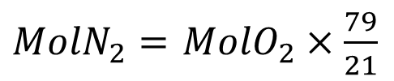
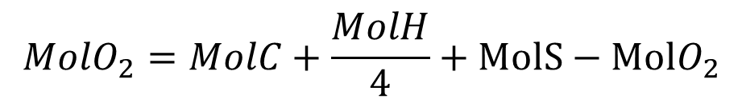
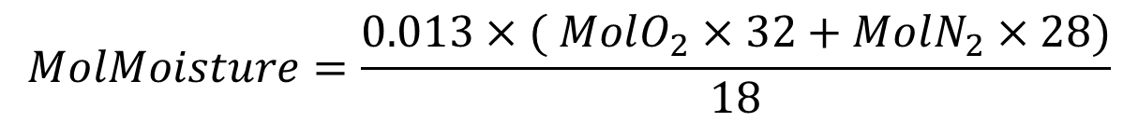

Air supply
$$MolO_{2}=MolC+\frac{MolH}{4}+MolS−MolO_{2}$$
$MolN_{2}=$ $MolO_{2}×\frac{79}{21}$
$$MolDryAir=MolO_{2}+MolN_{2}$$
$$MolMoisture=\frac{0.013×( MolO_{2}×32+MolN_{2}×28)}{18}$$
$$Theoretical air=MolDryAir+MolMoisture$$
$$Combustion air=AF ratio ×Stoichiometric wet air$$

Slide 37
Heat Balance
Steam Enthalpy
CBD
Flue gas heat content
Moisture latent heat in fuel
Unburned loss(C, CH4, CO)
Radiation Heat loss
Bottom ash loss
Fuel heating value
Fuel specific heat
Air specific heat
Boiler
Water Enthalpy
Desuperheater Enthalpy

Slide 38
Technical Specifications I
PROCESS DESIGN
COAL DATA SOMA LIGNITE
HEAT AND MASS BALANCE CALCULATION
WATER / STEAM CYCLE & TURBINE
COMBUSTION CALCULATIONS
CONSUMABLES AND RESIDUES
EMISSIONS
POWER GENERATION SYSTEM
MAIN STEAM GENERATION
FLUE GAS CLEANING (FILTER)
GENERAL AND PROCESS FEATURES
ESP / BAG FILTER PRELIMINARY DESIGN DATA AND DRAWINGS
FUEL & ASH HANDLING SYSTEMS
COAL HANDLING AND START-UP LIGHT FUEL OIL (DIESEL) SYSTEM
ASH HANDLING SYSTEM DESCRIPTION
AUXILIARY SYSTEMS
WATER AND WASTE WATER
COMPRESSED AIR SYSTEM
AUXILIARY STEAM GENERATOR
CLOSED COOLING WATER SYSTEM
CHEMICAL DOSING AND SAMPLING SYSTEMS
EMISSION MONITORING SYSTEM
LABORATORY

Slide 39
Technical Specifications II
ELECTRICAL SYSTEMS
GENERAL DESCRIPTION OF ELECTRICAL CONCEPT
CONCEPTUAL SINGLE LINE DIAGRAM
MODE OF OPERATION AND DESIGN PHILOSOPHY
COMPONENTS (e.g. Generator, Transformers, Isolated Phase Bus Bars (IPB), Generator Circuit Breaker (GCB), MV Distribution Switchgear, MV Cables, Electrical motors, Protection, Synchronization and Metering, LV-Equipment, Auxiliary equipment and systems, Connection to power transmission)
I & C SYSTEM
GENERAL CONTROL PHILOSOPHY
GENERAL CONCEPTS
DISTRIBUTED CONTROL SYSTEM (DCS)
PLANT CONTROL ROOM LAYOUT
CIVIL STRUCTURES AND LAYOUT
PLANT LOCATION
PLANT LAYOUT
SITE CONDITION AND PREPARATION
MAIN PLANT STRUCTUR

Slide 40
Economic Assessment
IMPLEMENTATION PROCEDURES
DISCUSSION OF CONTRACTING SCHEMES (E.G. EPC, Main Packages or Lot Oriented Contracting)
ASSESSMENT OF AVAILABLE ENGINEERING PARTNERS FOR DETAILED DESIGN
ASSESSMENT OF AVAILABLE BOILER SUPPLIERS
ASSESSMENT OF AVAILABLE SUPPLIERS FOR THE VARIOUS SYSTEMS AND COMPONENTS
IMPLEMENTATION SCHEDULE
ECONOMIC BASE DATA AND ASSUMPTIONS
COSTS FOR CONSUMABLES AND PRICES FOR ELECTRICITY
REQUIRED OPERATING AND MAINTENANCE STAFF
INVESTMENT COSTS
LIFECYCLE COST ANALYSIS
CAPEX and OPEX Cost Evaluation

Slide 41
Basic Design

Slide 42
Design Parts I
None pressure parts
Combustor
Distributor
Draft system (Fans)
Ducts
Cyclone
Loop seal
Convection pass
Air heater
Ducts

Slide 43
Design parts II
Pressure parts
Economizer
Water wall
Drum
Super heater
Attemperator
Piping
Feed water system (Pumps)

Slide 44
Design parts III
Environmental system
SNCR/SCR
Semi dry reactor
Bag filter
Stack
Installation frame
Control system

Slide 45
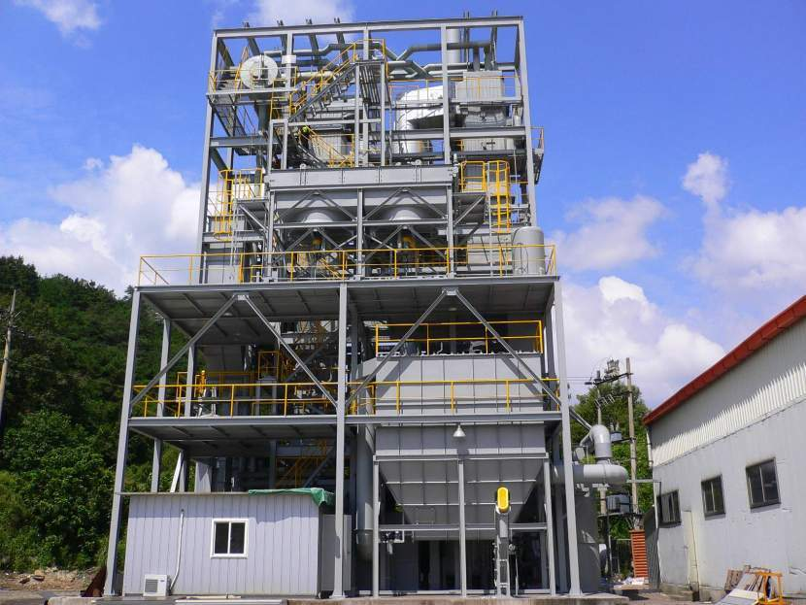
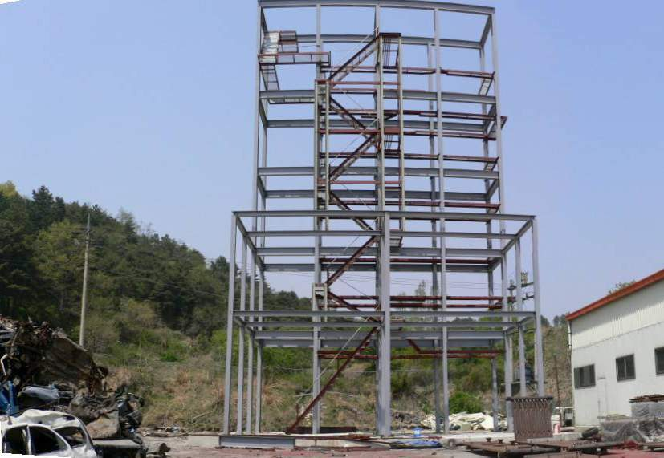
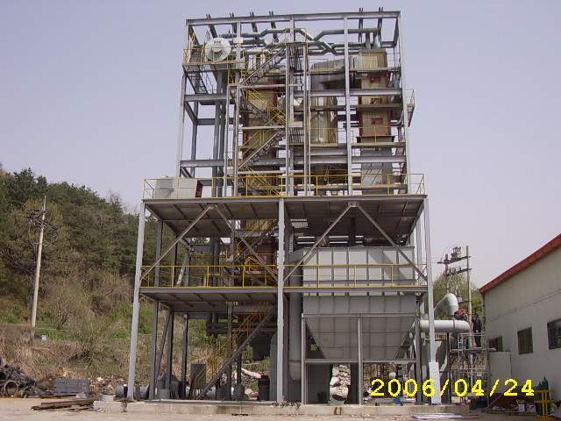
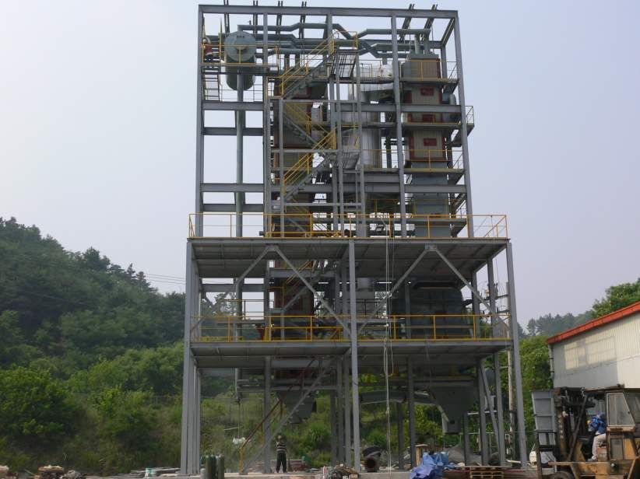
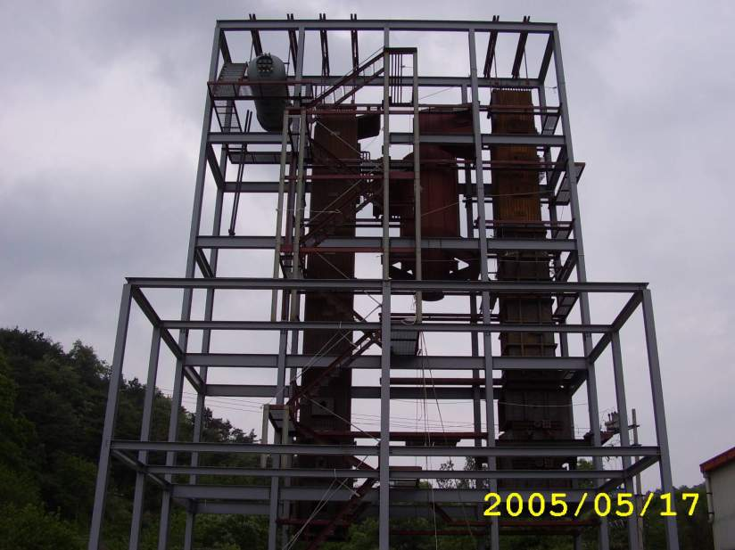
CFBC Demonstration plant constructon

Slide 46
Basic design I
Project management plan
Collection of basic parameter
PROJECT TEAM
COORDINATION PROCEDURE
SCHEDULE
Budget plan
MAN HOUR
BASIC DATA
BASIC Engineering and Design

Slide 47
Basic Design II
General Lay out
Piping & Instrument Diagram
Operational plan
Design specification
Mechanical
Piping
Electricity, Instrument, Control, Communication
Civil
Construction

Slide 48
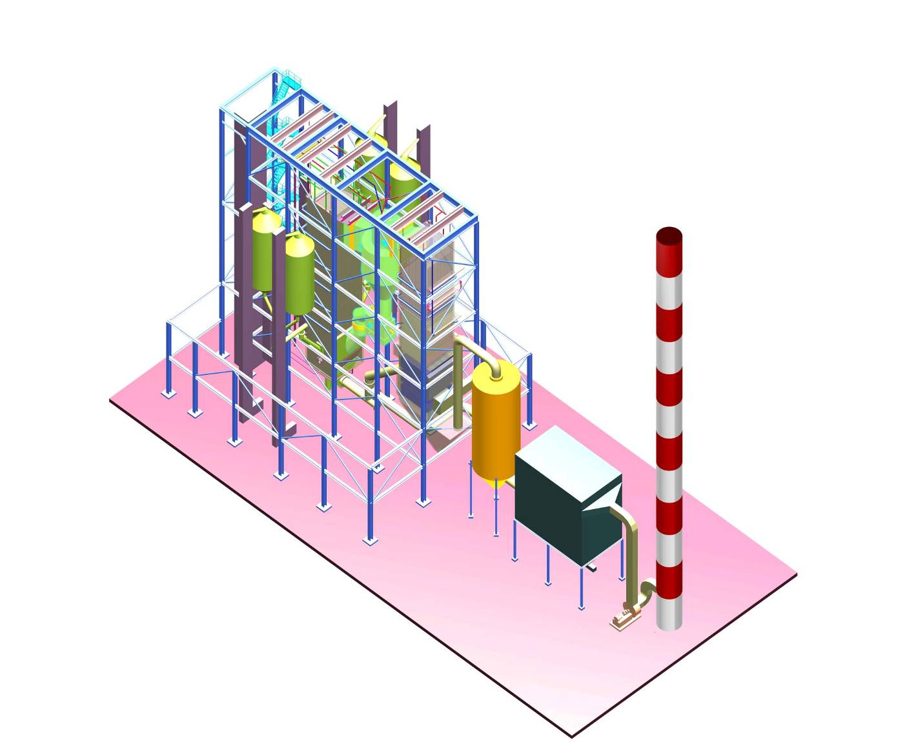
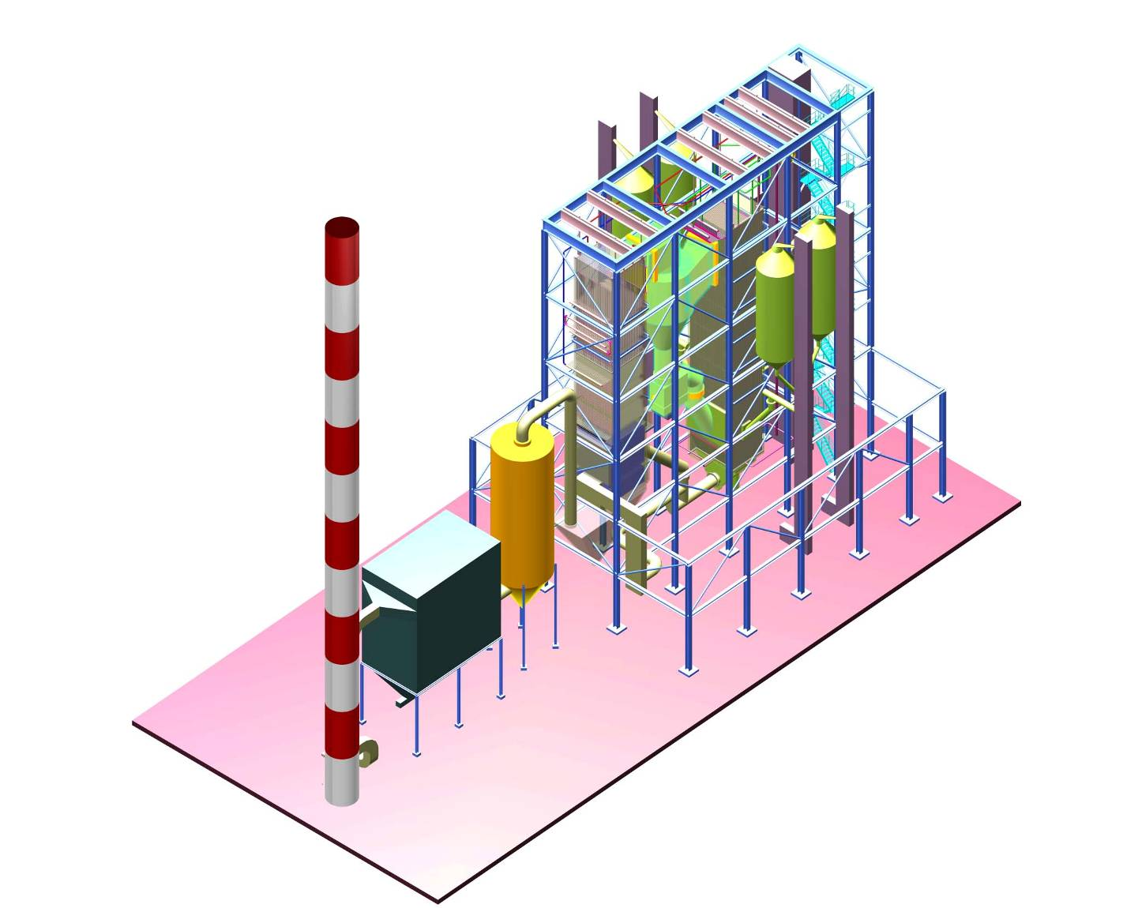
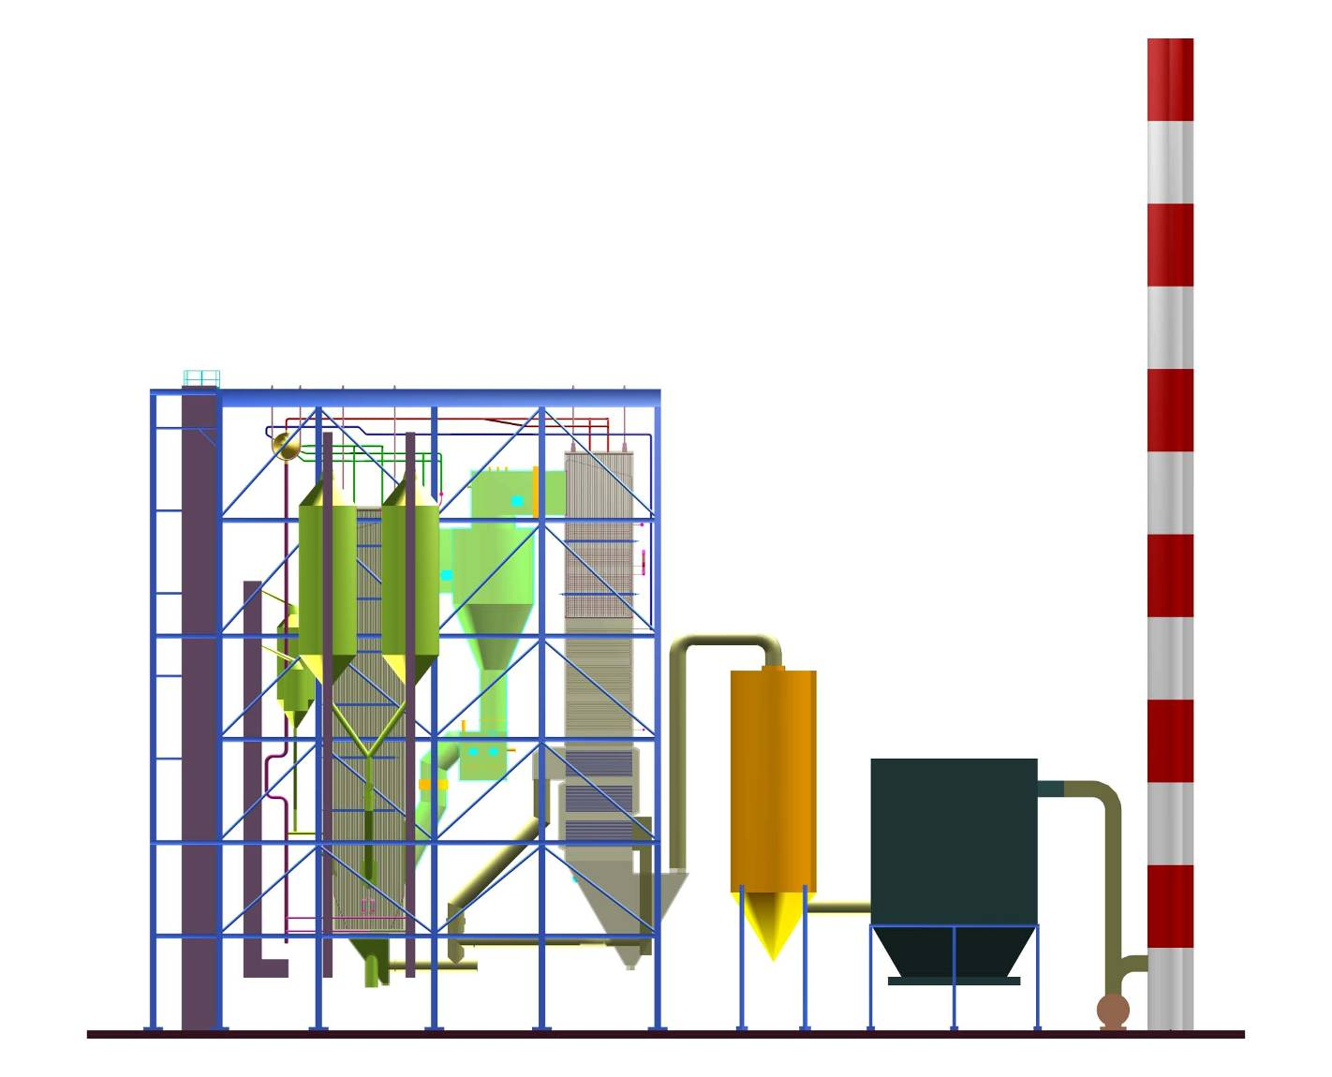
원주 10MWe 발전용 보일러 조감도

Slide 49
Lay out of Combustor and Back pass
Superheater
Combustor
Cyclones
Economizer
Air heater
B1
A1
B2
A2

Slide 50
Basic Design Document I
Performance calculation for guarantee points
Performance calculation for design points
Natural circulation calculation
Pressure drop calculations for water/steam, air/flue gas
Pre-calculation for stress analysis according to applicable code
Dimensioning of furnace, cyclone, tubing, piping, headers and drum
Dimensioning of ductwork, casings, supporting grid including static analysis
Primary internal pipework routing
Technological information on auxiliary piping
Technological information on blow-down vessels and other tanks
Primary design of hangers and supports for internal piping
General layout of boiler

Slide 51
Basic Design Document II
Heating surfaces layout
Basic design of drum body and internals
Graphs and diagrams of boiler performance
Correction curves for performance tests
Start-up diagram
P&I diagrams with KKS numbering for all systems within scope
List of valves and pipes (first draft with naming, labelling, medium, design pressure/temperature, dimension, material, drive)
Quality assurance: determination of standards, guidelines and systematic structure
Painting: determination of extent, preparation of surface, materials, number and thickness of layers, ral codes and application procedure
Labelling: determination of numbering system, materials, fixing methods and fonts to be used
Manuals: determination of structure and guidelines
Transport guidelines: routing, means, allowable sizes and weights

Slide 52
Basic Design Document III
Erection procedure: general description of procedure
Commissioning: description of the procedure, determination of cleaning method,
Guidelines for training
Assistance for design of main cable routing
Arrangement of platforms, stairs and emergency exits; access to manholes and inspection openings
Layout drawing of steel structure
Static analysis of the steel structure
Foundation load diagram
Determination of axis and grid system, determination of the +/- 0,00 m reference level
Design of embedded parts (foundations)
Implementation planning of boiler accessories
Definition of equipment to be insulated

Slide 53
Detail Design

Slide 54
Engineering Design
INFORMATION이 document, drawing, SPEC.
Confirm BEDD, PFD, PROJECT SPEC., P&ID, PLOT PLAN등 INFORMATION
PROCESS, Mechanaical, Piping, Instruemnt, Electricity, Civil, Construction

Slide 55
Design Items
Mechanical – Combustor, Cyclone
Piping – Feed water, Tubes
Facility – Major facilities
Electricity – lighting, Power
Instrument & Control – DCS
Civil – Pavement and and drainage
Construction – Structure and construction

Slide 56
PROCESS DESIGN REQUIREMENT I
Facilities | Items | Criteria | Ref.
CFBC | Unit | 1
 | type | Natural circulation
 | installation | In house
 | Power | 10MWe
 | Steam rate | 60ton/h
 | Final steam temp. | 452℃
 | Final steam pressure | 45ata
 | Feed water temp. | 143 ℃

Slide 57
PROCESS DESIGN REQUIREMENT II
Facilities | Items | Criteria | Ref.
CFBC | Boiler efficiency | 83% | HHV
 | Process steam | 12ton/h | steam
 | Process steam P. | 12ata
 | Environment | 20 ℃
 | Humidity | 70%
 | Minimum loading | 50%
 | Support | suspended
 | Main fuel | RDF
 | Start up fuel | Diesel
 | Fuel consumption | 11ton/h
 | HHV of fuel | 4500kcal/kg

Slide 58
Rear
구 분 | 단위 | Dense bed | Furnace | C. B.
Velocity | m/s | 5.0 | 5.0 | 12
Gas flow | N㎥/s | 12 | 19 | 19
Temp | ℃ | 850 | 820 | 800
Area | ㎡ | 10 | 16 | 6
Width/Depth |  |  | 1.00
Width(wf(wd)) | m | 4.0 | 4.0 | 4.0
Depth(df(ld)) | m | 2.5 | 4.0 | 3.5
Residence Time | Second | 1.3 | 3.4
Height(hde, hff) | m | 8.00 | 16.00
Ceiling Height(gf) | m |  | 1.09
Furnace outlet | ㎡ |  | 4.5
Free Board Heating Surface | ㎡ |  | 277
Front
X
X
X
X
X
X
X
X
X
X

Slide 59
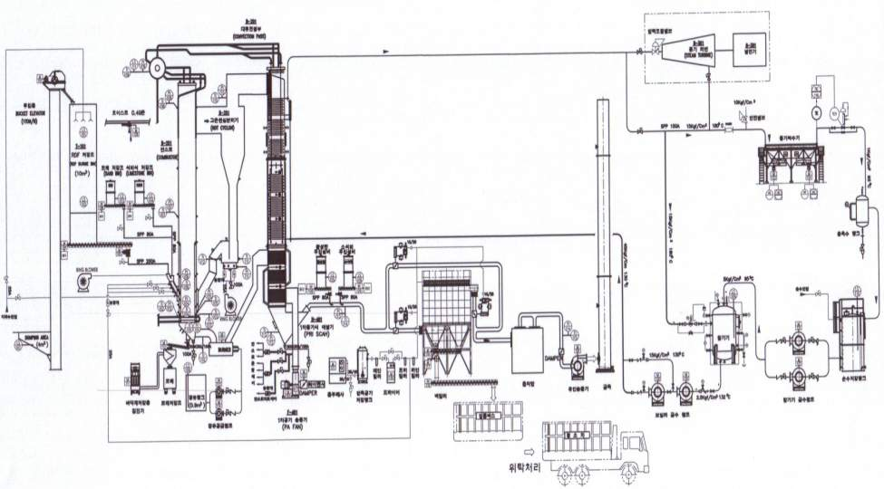
Engineering Design
1MWe CFBC Process Diagram

Slide 60
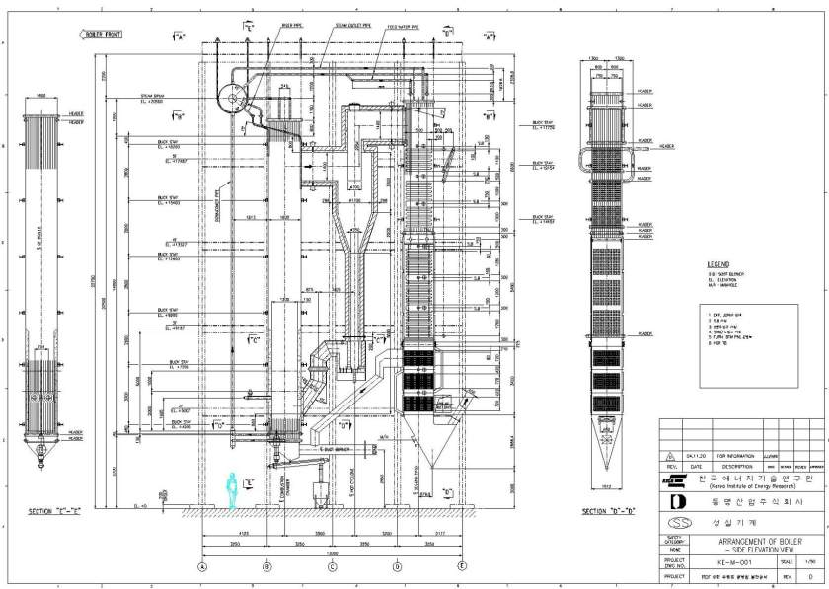
Combustor

Slide 61
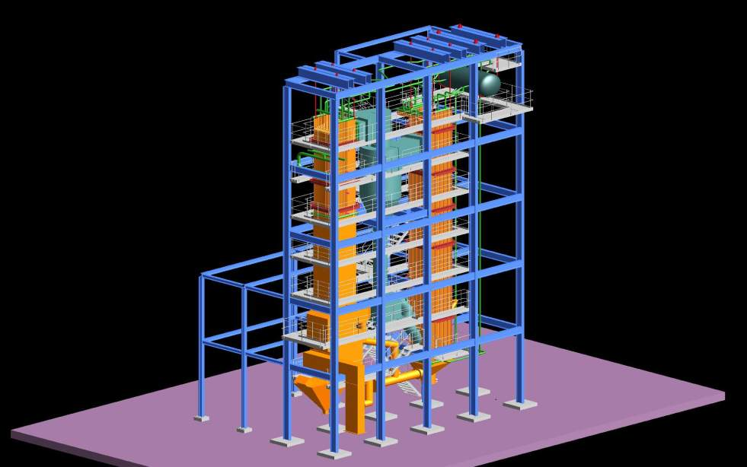
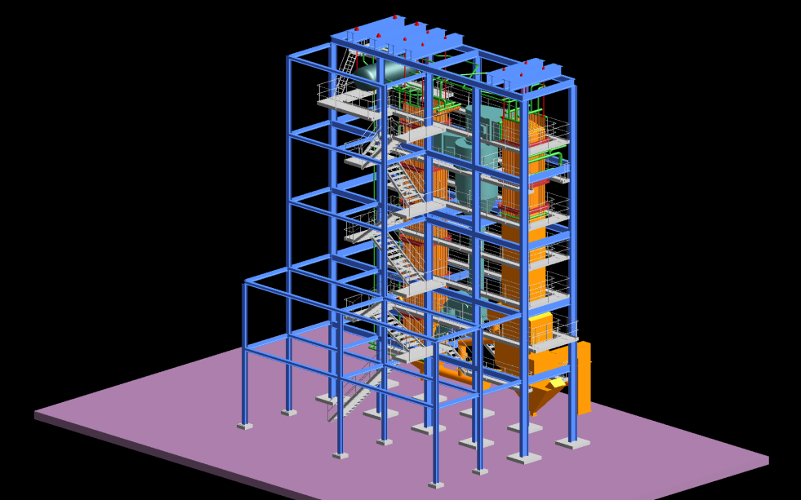
Bird eye view

Slide 62
CFBC Demonstration plant constructon

Slide 63
Detail Design Document
List of valves and pipes
List of hangers and supports
Insulation requirements
List of expansion joints
Stress analysis according to code of selected components including materials selection (as far as required by applicable laws)
Elasticity analysis of boiler pipework (as far as required by applicable laws)
Collision check
Location planning of all valves and control valve stations
Detailed design and calculation of hangers and supports
As-built drawings of contractor's scope of supply
Preparation of documents for authority approval as far as necessary and related to contractor's scope
Manuals as defined in contract
Erection: basic information like weight list, equipment list, description of the procedure, check of erection/welding concepts.
Insulation: table for all equipment to be insulated with geometrical data, equipment surface, temperature, type of fixing structure, mounting instruction, insulation material design

Slide 64
Electricals and I&C I
Instrument list: specification of entire instrumentation regularly updated according to design progress
Logic diagrams open/closed loop controls: process related diagrams for all control tasks, independent from the applied automation system; presentation is independent from used instruments type, signal power, cable run and place of installation using standardized graphic symbols and additional text information
Electrical consumer list: specification of all consumers regularly updated according to design progress

Slide 65
Electricals and I&C II
Signal list for signal exchange of black box systems with DCS (separate for hardwired and bus signals)
Arrangement drawings showing the location of instrumentation, control equipment and electrical components
Documentation for black box systems; following information is at least provided:

Slide 66
감사합니다.

